Slide 1
NeuroCurrent Architecture
By Shifa Zhang
May, 2017

Slide 2
General Idea
Simulates neural network continuously
Closes the loops of perceptions and actions
Provides a framework
Provides standard perception sensors and action drivers
Supports neural circuit custom design
Combines reasoning system and neural circuit
Reasoning system provides expected results base on reasoning logic
Neural circuit processes senor signals and generate action controls

Slide 3
Framework
Sensors and drivers are standard to the framework
Neural circuit can be custom before each run
Reasoning system is event driven task management system. Each task performs a serial reasoning steps.
The reasoning rules are learned from the neural circuit
The outputs of the reasoning are neural signals to neural circuit
Reasoning system
Neural circuit
Sensors
Drivers

Slide 4
Neuron Model and Behaviors
Integration: Supports standard linear weighted accumulation integration of inputs or custom integration
neu = c_neuron(b) #create a neuron “neu” with default value b
add_syn(ax, neu, w, t) #add a synapse from an axon “ax” to a neuron “neu” with a weight “w” and delay “t”
Standard integration:
x = b + S_{i}∙W_{i}^{T} # create a virtual synapse
where S_{i} = (s_{i1}, s_{i2}, s_{i3}, …, s_{in}), W_{i} = (w_{i1}, w_{i2}, w_{i3}, …, w_{in}), b is default value of neuron
User can write a function to define custom integration
Activation: users can use ReLU (max(0,x)) or define custom functions to active the neuron and synapse
Learning: Support Hebbian learning or custom learning algorithms.
a_{i1}
s_{i1}
w_{i1}
x
a_{o}
a_{in}
s_{in}
w_{in}
Basic Model of a Neuron

Slide 5
Neural Circuit and Simulation
The interconnected neurons form a neural circuit
Simulation
Calculate the values of very neuron in the network on very unit time
Unit time can be configured on system level, normally 10~100 ms
Interact with real world, real time simulation
x_{r1}
x_{k1}
a_{o1}
a_{i1}
x_{j1}
x_{r2}
x_{k2}
a_{o2}
a_{ip}
x_{jm}
x_{rn}
x_{kq}
a_{oq}
Neural Circuit Model

Slide 6
Example 1: Neural Network for “Light Spot Orientator”
Turn left
Turn right
Pixel
Network
Virtual
Screen
Vertical
Max
Horizon
Max
Action
Network
Light Spot Orientator: always turning to the direction facing the lightest spot in the perception field.

Slide 7
Max Operation Neural Network
4 input Max network example
1
-
-
-
-
+
+
+
---
1
-
-
-
--+
+
+
-++
-
-
1
+
OR
+++
-
1
Comparing matrix
NAND
Shunting
Inhibitant

Slide 8
Example 2: Object Orientator
Spatial Temporal
Network
Surveillance Network
Pixel
Network
Feature
Network
Pattern
Network
Object mapping
Network
Action
Network

Slide 9
Reasoning System
Includes inductive and deductive reasoning
It is a multi-task reasoning system
Internal status includes:
Rules, relations
Reasoning programs
Each task run a set of reasoning program, create outputs to the neural circuit according to the inputs from the neural circuit and internal status

Slide 10
Sensors and Drivers
Sensors:
Video cameras
Sound microphones
Vibration and Pressure sensors
Drivers:
Moving motors
Camera rotating motors

Slide 11
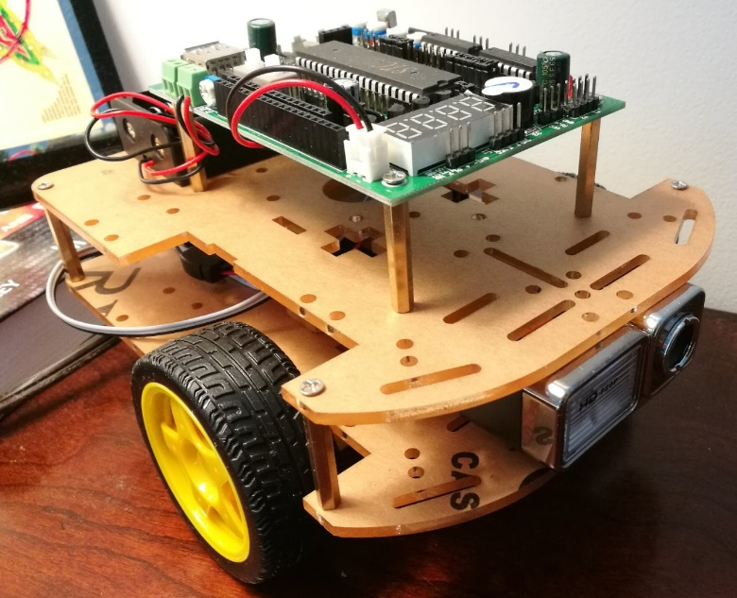
System Design
Hardware:
Front end: A self-moving car carries sensors
Back end: A computer runs neural circuit simulation and reasoning system, communicates with the front end through WIFI, receiving sensor signal and sending motor control instructions.
Back end platform:
Personal computer or server
Neural simulator and reasoning system software developed in C++
Neural circuit custom tool:
Provide Python3 library. Users can design their own neural circuit with the library.
Front end car

